Slide 1

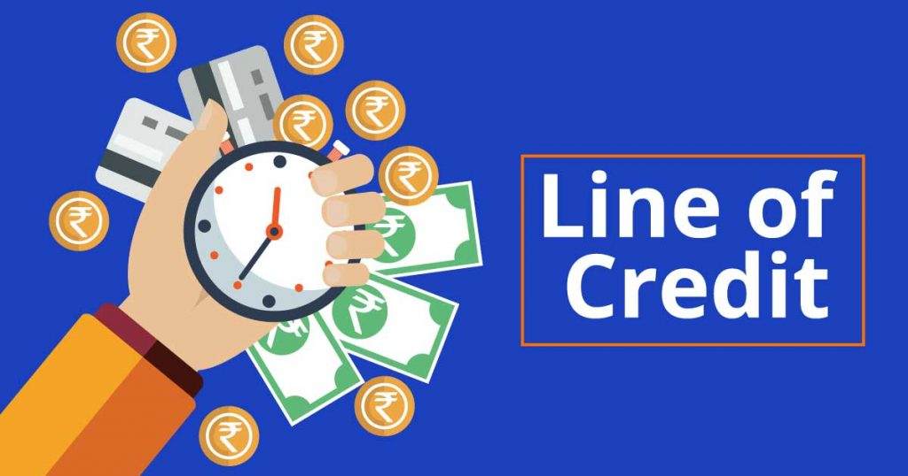
MICRO CREDIT LOAN
Abhishek kumar

Slide 2
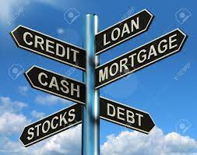
ABOUT MICRO CREDIT LOAN
Micro Credit, a value-added service designed on the premise of “what the consumer needs”, provides ease of access of airtime stock credit to resellers of a telecom operator when they run out of balance, without disrupting the normal flow of business. Micro Credit is an open and transparent service with a clear reporting structure. The telecom operator incurs zero cost, capital expenditure or credit risk as all investment is managed and handled by SDS
.

Slide 3

PROJECT INFORMAION
This Project is very interesting as it includes a real time problem for MFI. MFI stands for Micro-Finance Institution which offers financial services to low-income populations. Many MFI , experts and donors are supporting the ideas of using Mobile Financial Services(MFS). MFI provides a Micro-Credit Loan on mobile balances to the poor families in remote area which is to be paid in 5 days.
If a consumer unable to pay back the loan amount, it will be mark as defaulter.
For the loan amount of 5 (in Indonesian Rupiah), payback amount should be 6 (in Indonesian Rupiah), while, for the loan amount of 10 (in Indonesian Rupiah), the payback amount should be 12 (in Indonesian Rupiah).
We need to find target customers who can payback the credit on time. This can be observed by their avg usage of Mobile and their credibility of repayment.
MICRO LOAN

Slide 4

DATASET INFORMATION
The dataset is a csv file with 37 attributes With proven experience in managing high volume transactions, SDS acts as a virtual strategic dealer and provides instant loan to ensure reseller business continuity at all times. This dynamic service is powered by intelligent user profiling and is capable of recovering the loan amount automatically at the time of next recharge.
To get a limited amount of loan, resellers dial a pre-defined USSD short code. Micro Credit system receives the request and after performing various verifications and validations, processes the disbursement of loan amount accordingly.
(36 features and 1 target).
It has 209593 rows and 37 columns.
The target variable is either 1 or 0 which means non defaulter and defaulter, respectively.
The other key attributes are the account balances, days since last recharge, age on network, median recharge balance for 30 and 90 days and many more. The similar attributes for 30 and 90 days are highly correlated and conveys the same.

Slide 5
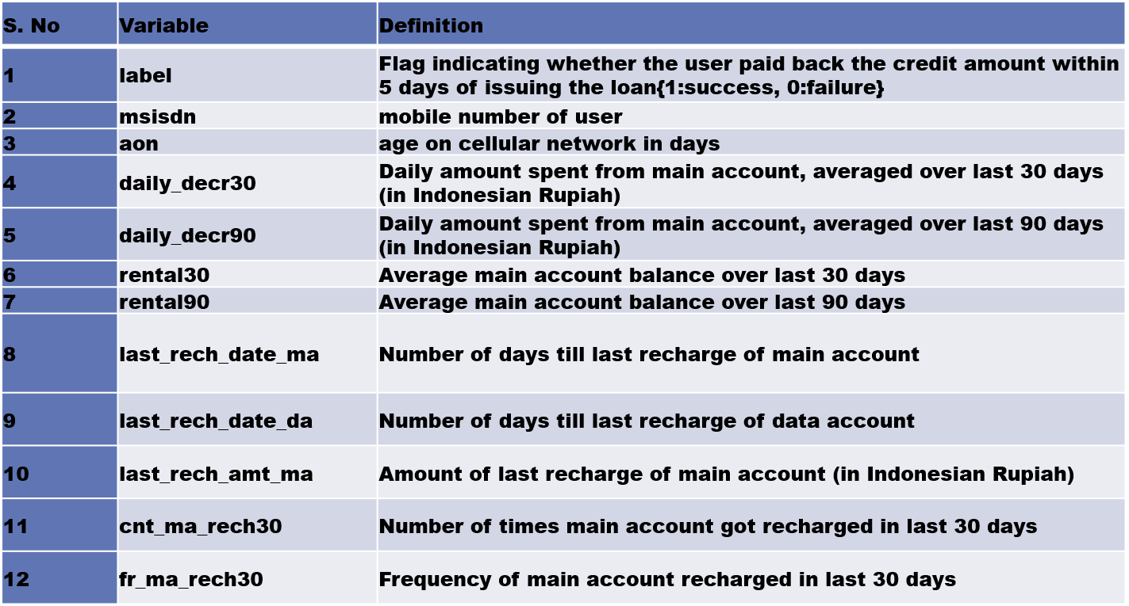
Description of Features

Slide 6
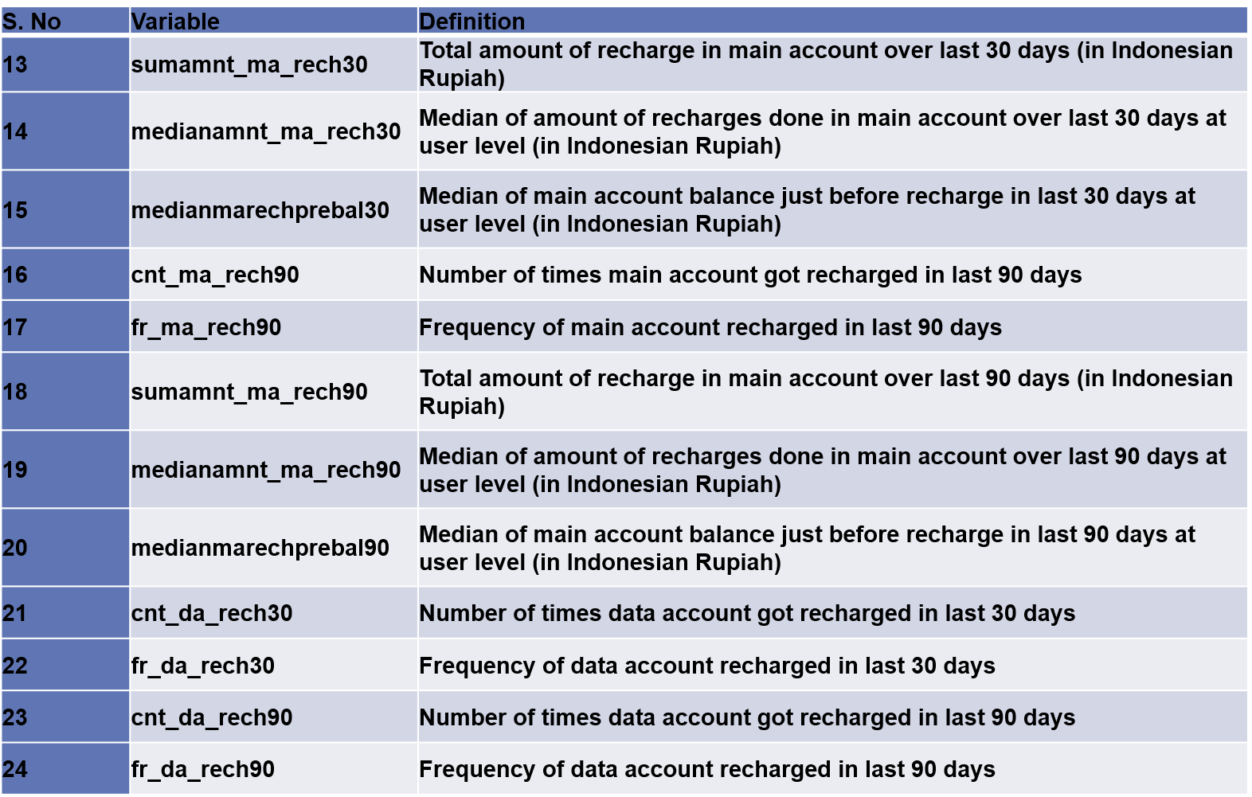
DESCRIPTION OF FEATURES

Slide 7
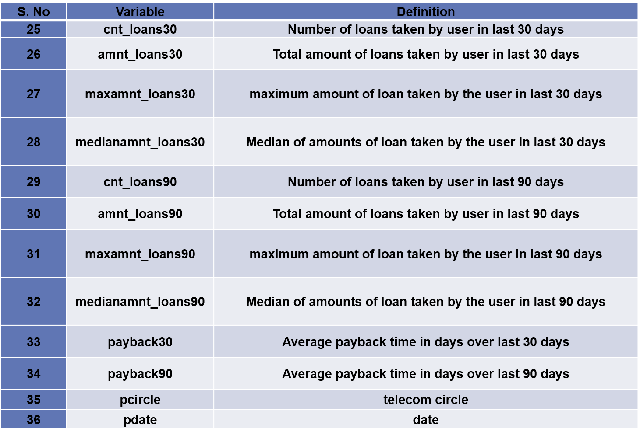
DESCRIPTION OF FEATURES

Slide 8
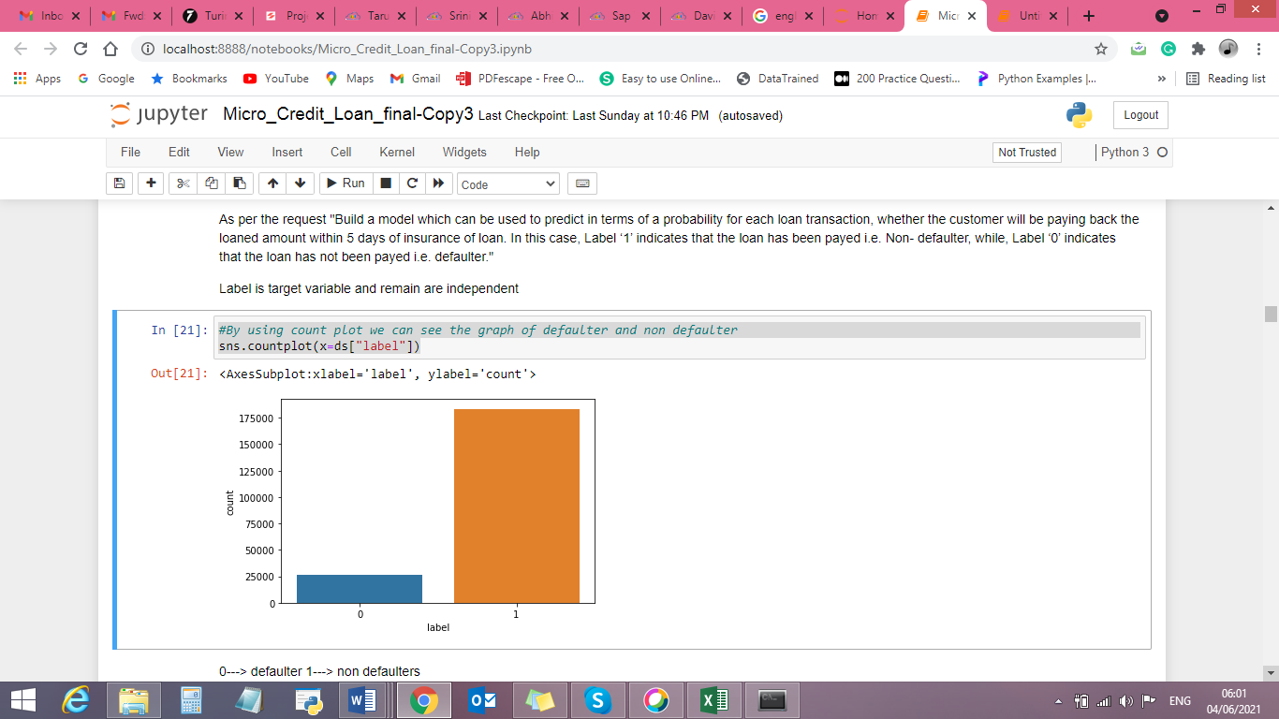

Slide 9
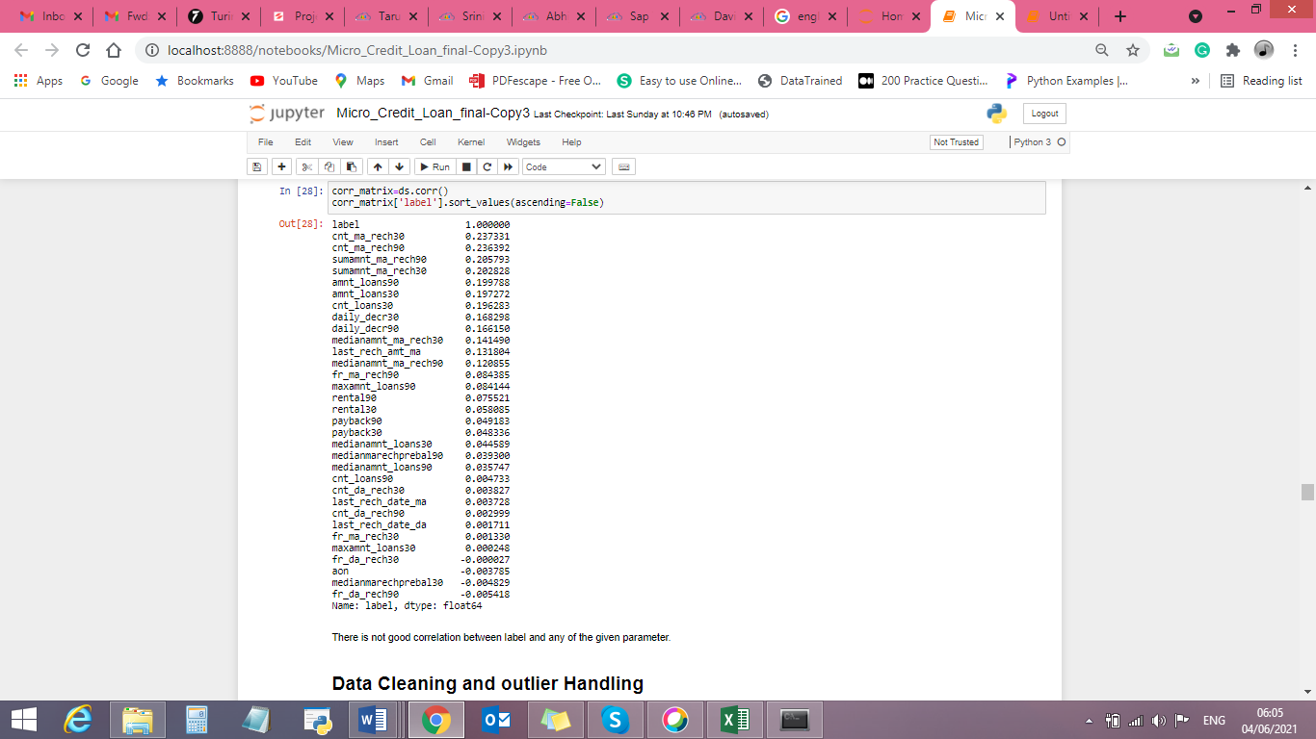
CO-RELATION OF DATASET

Slide 10
What I understand from Micro-credit loan Project?
In case of subscribers or end consumers of telecom operators, this service is one step ahead of the Call Me Back feature that allows a subscriber to send a message to another subscriber to call him back in case he lacks the airtime to make the call himself.
Micro Credit on cell phone balances is very useful to customers which help in having uninterrupted communications.
Targeting the selected customer who are creditable in repaying of Micro Loans help Telecom Company a repetitive cashflow and customer satisfaction is achieved.
Communication being important part no one want to run out of balance and these leading would help in missing out the service blockages and helps in never ending customer lifetime with the brand.
Focus is on providing their services and products to low-income families and poor customers that can help them in the need of hour.

Slide 11
MODELS DEVELOPMENT AND EVALUATION
import numpy as np
import pandas as pd
import seaborn as sns
import matplotlib.pyplot as plt
from sklearn.linear_model import LogisticRegression
from sklearn.naive_bayes import GaussianNB
from sklearn.tree import DecisionTreeClassifier
from sklearn.svm import LinearSVC
from sklearn.svm import SVC
from sklearn.neighbors import KNeighborsClassifier
from sklearn.ensemble import RandomForestClassifier

Slide 12
MODELS DEVELOPMENT AND EVALUATION
from sklearn.ensemble import AdaBoostClassifier
from sklearn.ensemble import GradientBoostingClassifier
from sklearn.metrics import accuracy_score,confusion_matrix,classification_report
from sklearn.preprocessing import StandardScaler
from sklearn.model_selection import train_test_split
from sklearn.preprocessing import PowerTransformer
from sklearn.preprocessing import power_transform
from sklearn.model_selection import GridSearchCV
from sklearn.model_selection import cross_val_score
from sklearn.metrics import roc_curve
from sklearn.metrics import roc_auc_score
import joblib
import warnings
warnings.filterwarnings("ignore")

Slide 13
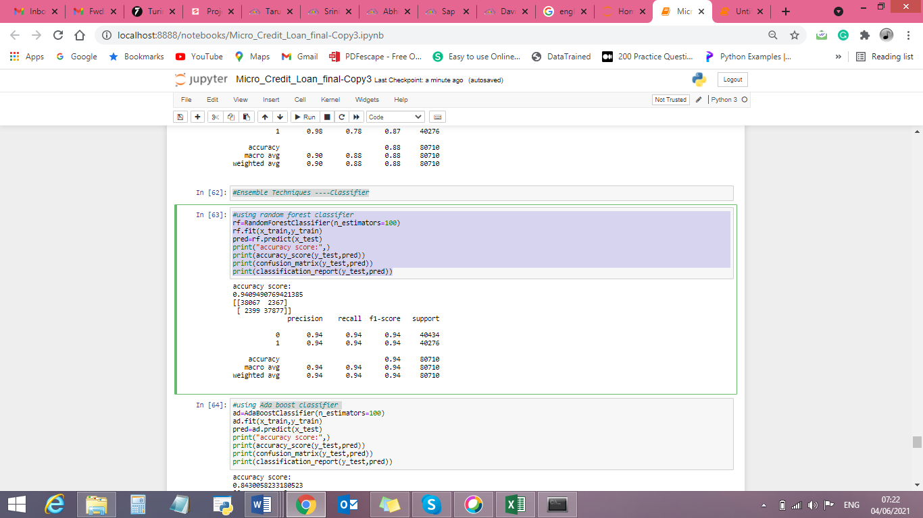
MODELS DEVELOPMENT AND EVALUATION
Run and Evaluated Selected models

Slide 14
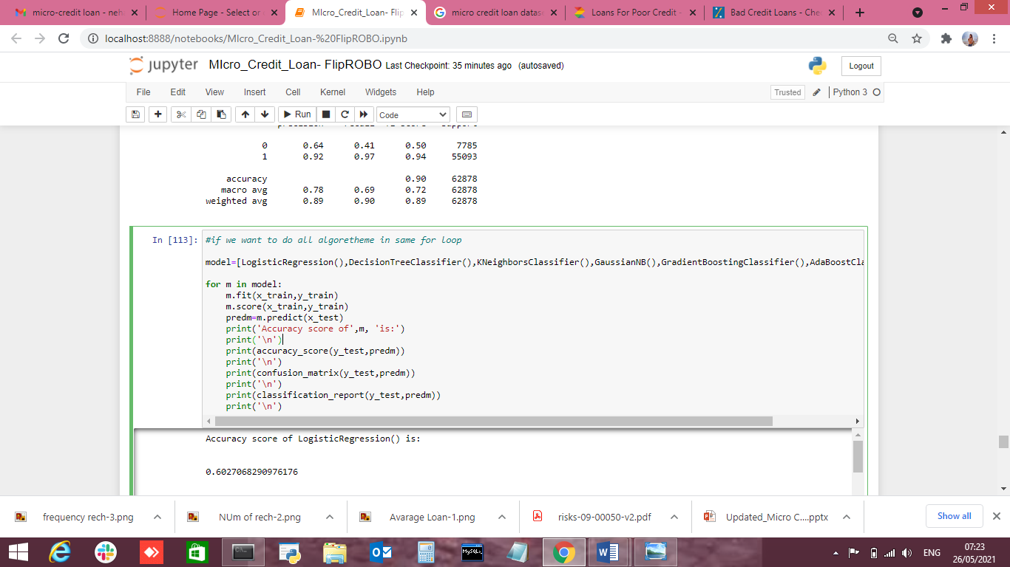
MODELS DEVELOPMENT AND EVALUATION

Slide 15
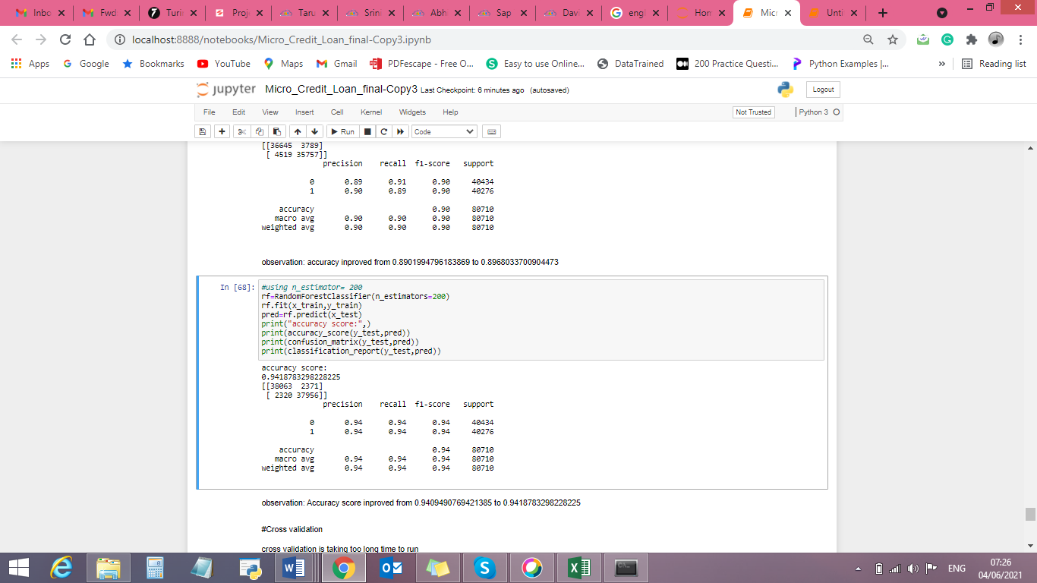
RandomForest Classifier
MODELS DEVELOPMENT AND EVALUATION

Slide 16
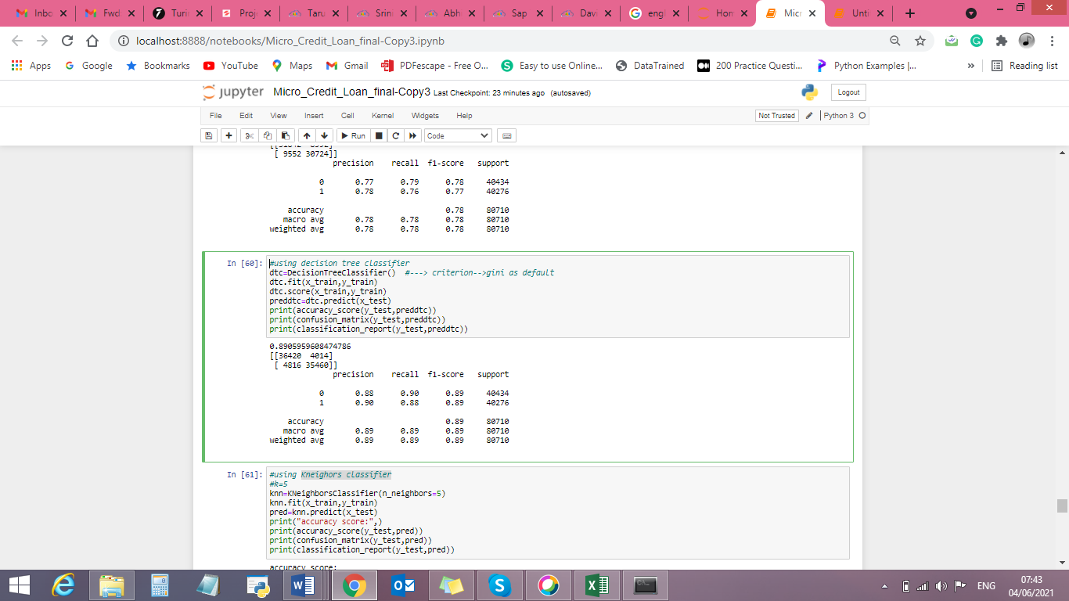
DecisionTreeClassifier
MODELS DEVELOPMENT AND EVALUATION

Slide 17
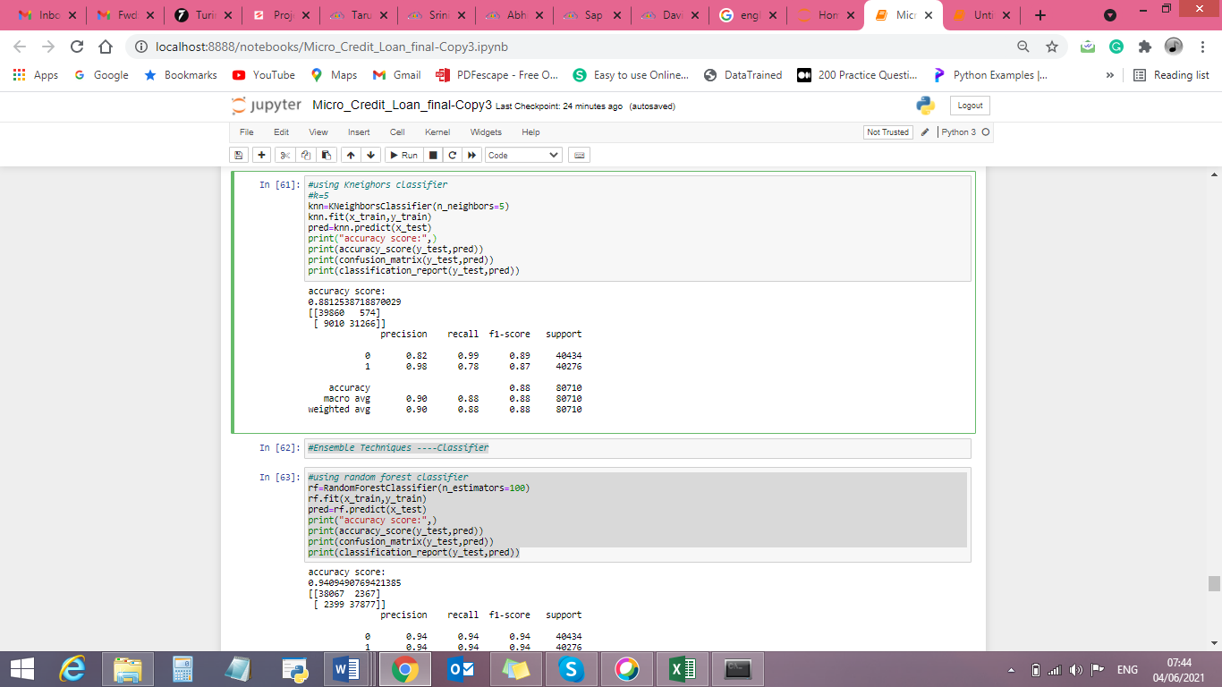
KNeighborsClassifier
MODELS DEVELOPMENT AND EVALUATION

Slide 18
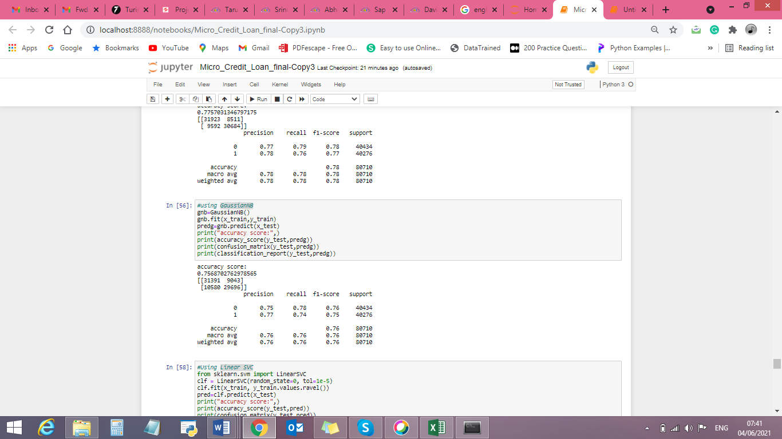
GaussianNBclassifier
MODELS DEVELOPMENT AND EVALUATION

Slide 19
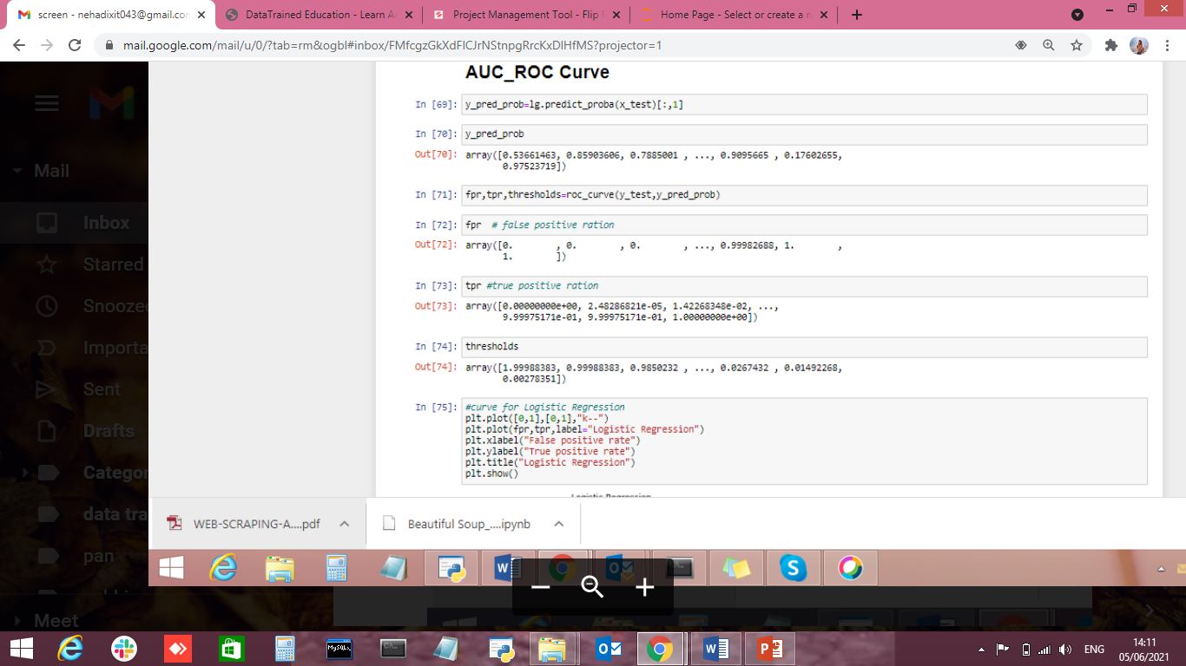
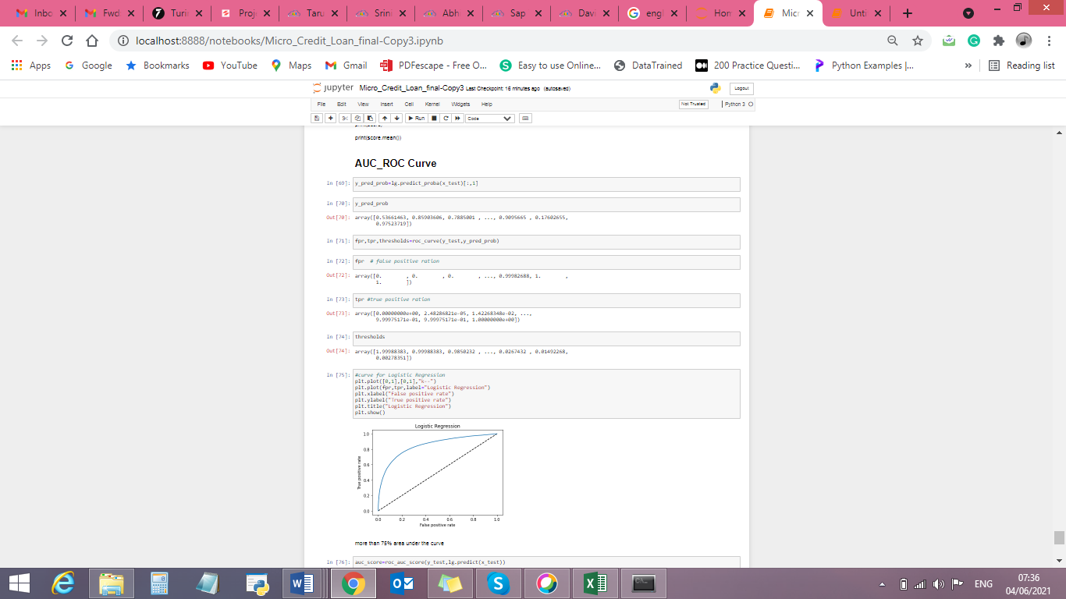
AUC_ROC Curve (True Positive Rate)

Slide 20
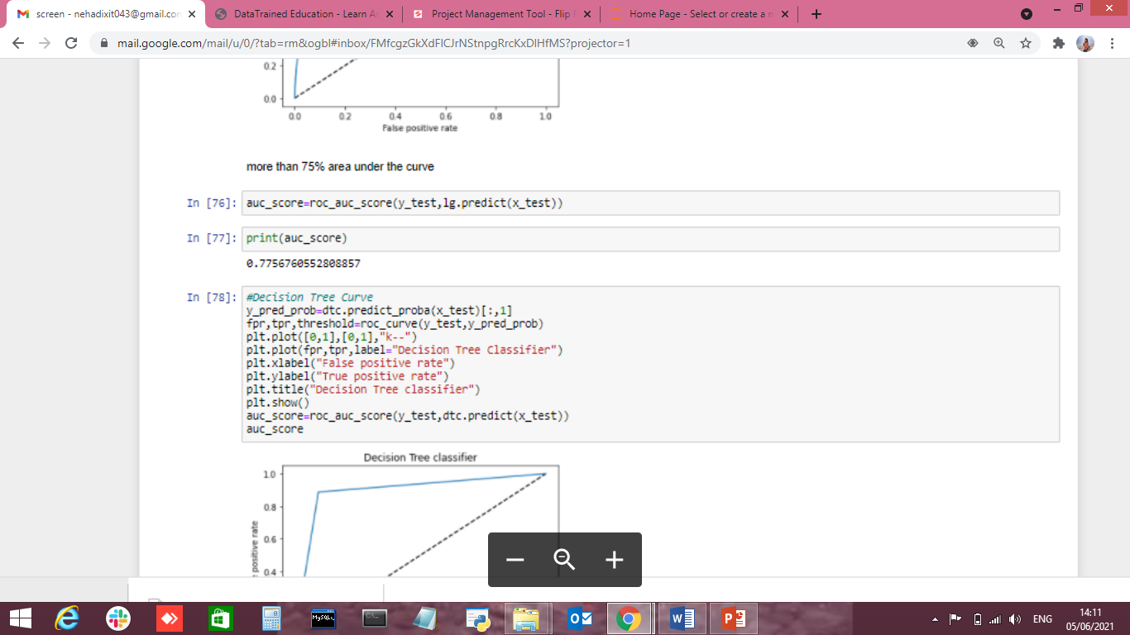
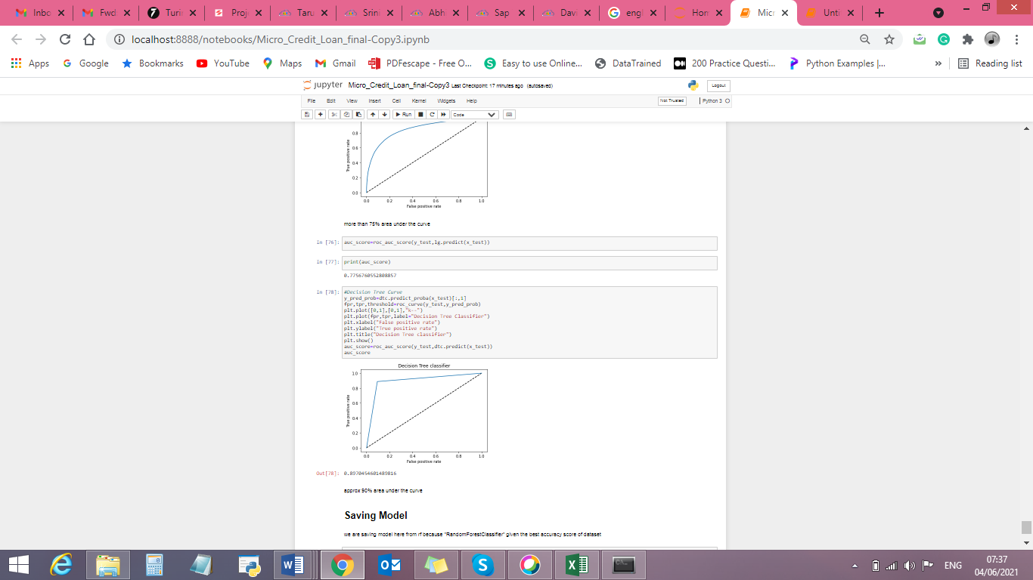
AUC_ROC Curve ( False Positive Rate)

Slide 21
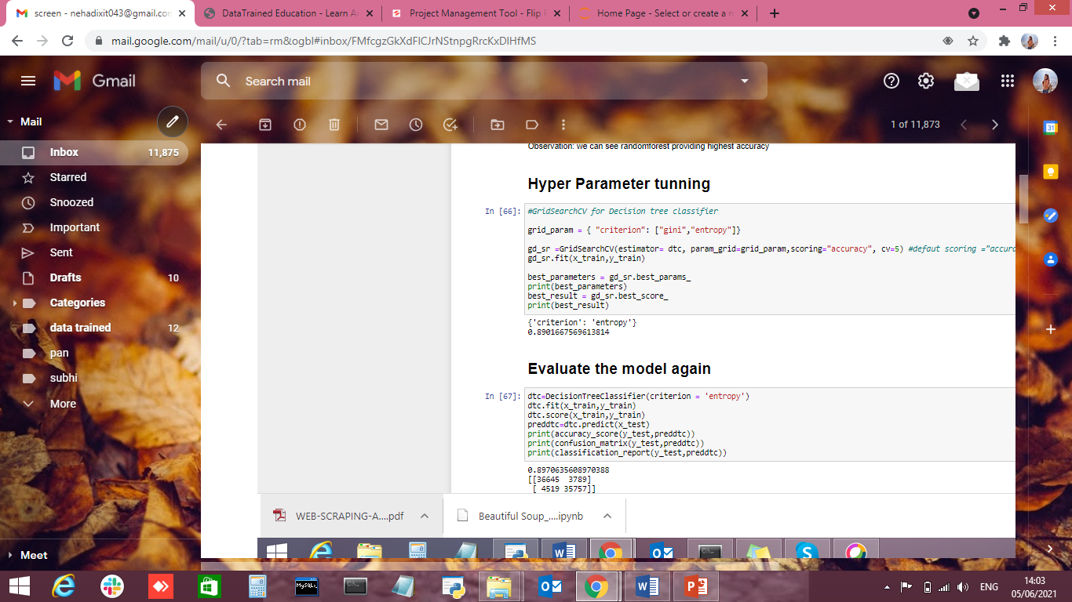
HYPERPARAMETER TUNNING
MODEL EVALUATION

Slide 22
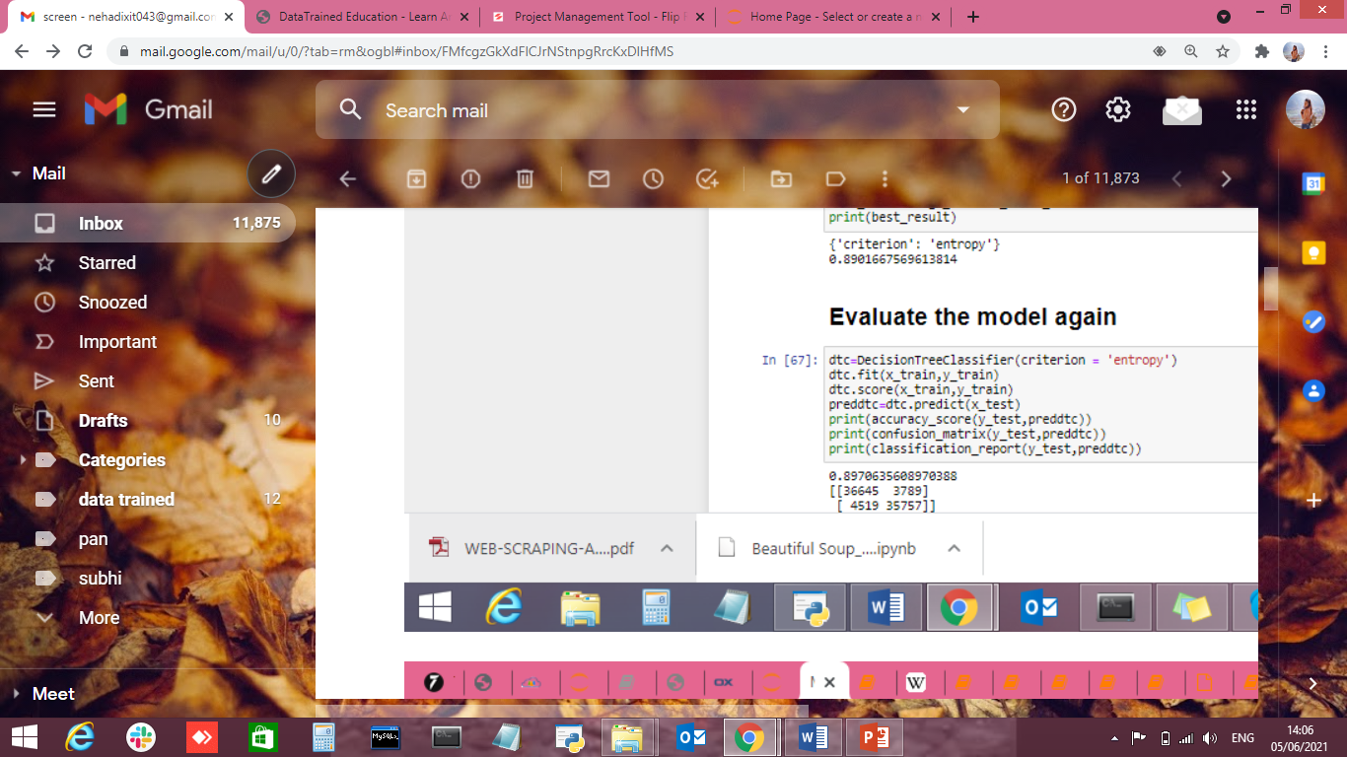
MODEL EVALUATION
HYPERPARAMETER TUNNING

Slide 23
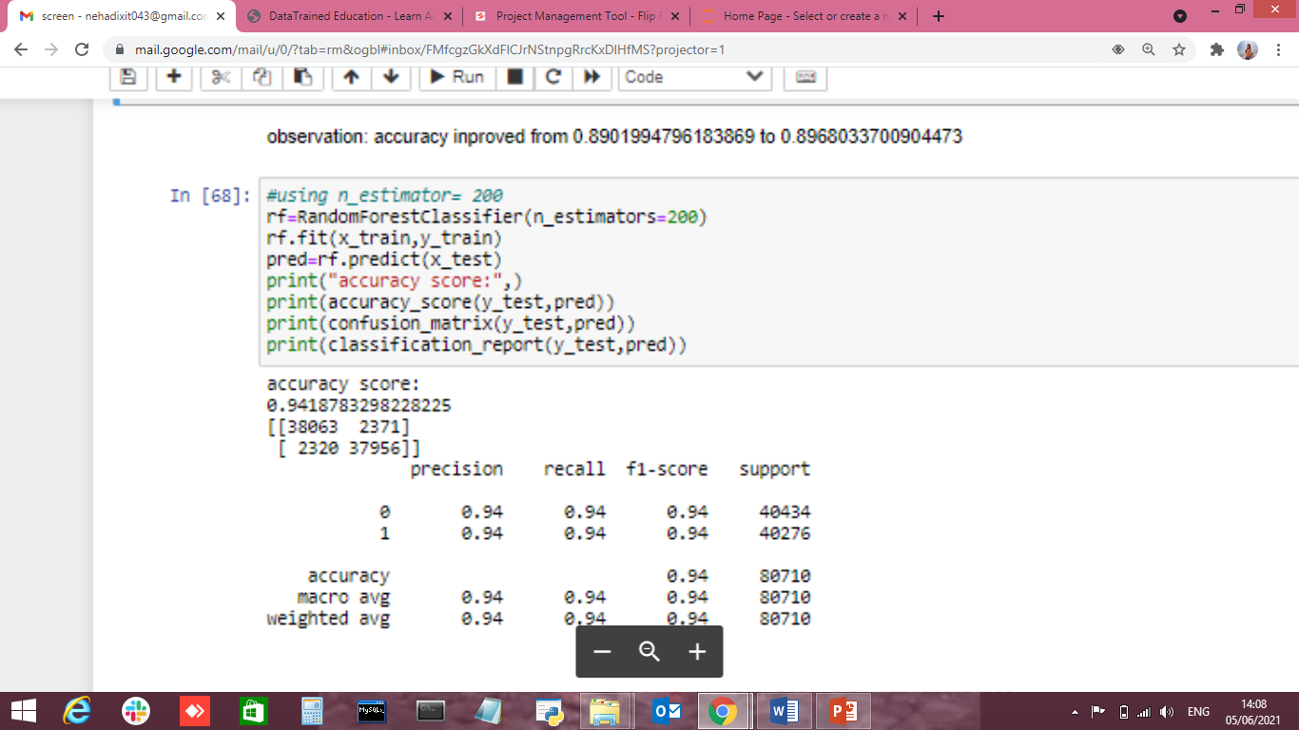
MODEL EVALUATION
HYPERPARAMETER TUNNING

Slide 24

MODEL PERFORMANCE
Having the error 0
Random Forest Classifier model is the best model when compare with other models.

